Slide 1

Student Mobility
Hazem Nounou
Associate Dean for Academic and Student Services
Texas A&M University at Qatar

Slide 2
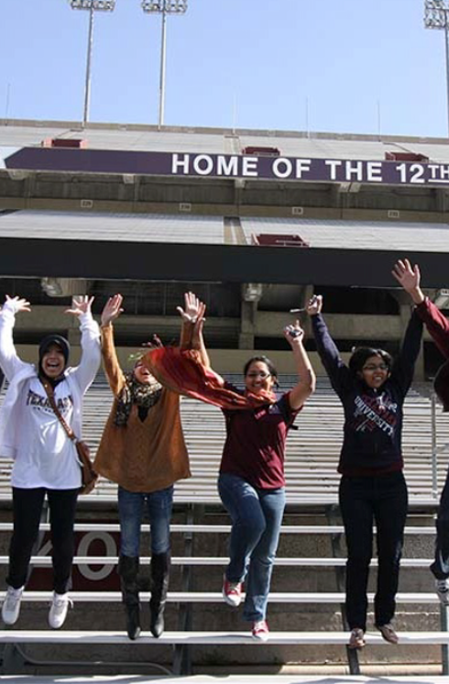
Main Message
High-5 Strategic Priorities
What do we mean by student mobility and what are our goals?
Where do we stand in terms of achieving our goals?
What programs will we offer to achieve our goals?

Slide 3
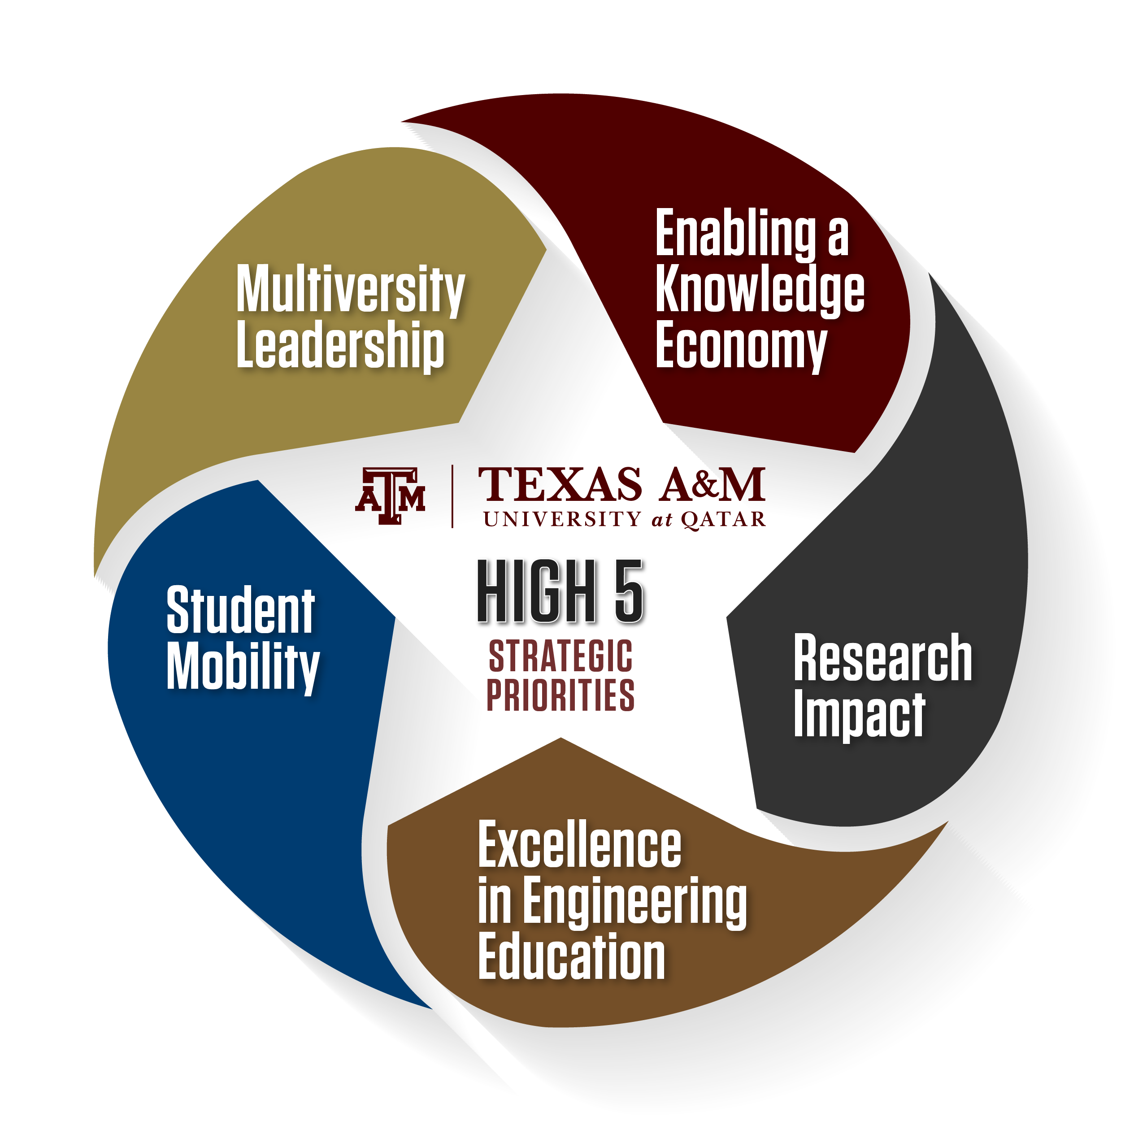
Leading QF’s Flagship Initiatives and Multiversity
Enabling a Knowledge Economy through a Ph.D. Fellows Program
Increasing Research Impact on the Economy and the Society in Qatar
Emphasizing Excellence in Engineering Education
Expanding Student Mobility Within Education City and Between Doha and College Station

Slide 4
What do we mean by student mobility?
The main objective of the Student Mobility priority is to connect TAMUQ students with TAMU main campus and other Partner Universities (PU) in Education City (EC).
Connect TAMUQ students with TAMU main campus:
  every TAMUQ student spends at least one week on main campus during their undergraduate studies. This could include leadership exchanges, conference attendance, study abroad or research experience programs, among other opportunities.
  bring at least 200 students from TAMU to Doha every year. This includes all undergraduate and graduate students participating in all travel programs.
Connect TAMUQ students with EC PUs:
  every TAMUQ undergraduate student, by the time of graduation, complete at least two courses at other EC PUs.
  increase course offerings of relevance and interest to students in other partner universities.

Slide 5

Where do we stand in terms of these goals?
Connect TAMU-Qatar to TAMU-CS:
Percentages of students traveled to College Station from 2016-2022 (SP)
Notes:
  Increase in Research Exchange
  Decrease in study abroad travel due to COVID pandemic
  Student Leadership Exchange did not travel in 2021

Slide 6
Where do we stand in terms of these goals?
Study abroad to/from College Station:
Initiatives:
  For TAMUQ students:
    Wintermester 2022/23 COMM 365 faculty-led course to College Station (17 students)
    Study abroad impacted by FIFA WC Fall 2022
    Travel to College Station resumed summer 2021
  For TAMU students:
    Two faculty-led program from CS in Wintermester 2022/23 (RPTS - 14 & Mays - 8)
    Travel to TAMUQ was reinstated spring 2022
    TAMUQ decided to cover the housing cost for all TAMU students.

Slide 7
Where do we stand in terms of these goals?
Summer Research Exchange Program:
Initiatives:
  For TAMUQ students:
    Undergraduate student travel was cancelled in 2020-2021 (spring/fall)
    REU to College Station resumes summer 2021
  For TAMU students:
    Undergraduate student travel was cancelled in 2020-2021 (spring/fall)
    REU to Qatar will resume summer 2022 (pending COVID restrictions)

Slide 8

Where do we stand in terms of these goals? (cont.)
Connect TAMU to TAMUQ:
Current 2022 data:
  Study Abroad:
    Fall 2022: 10 students
    Spring 2023: 7 students

Slide 9
Where do we stand in terms of these goals?
Total EC Students Cross-Registered at TAMUQ:
HEI
* Represents the total number of students taught across all courses enrolled per academic year
* Academic Year is Fall, Spring, Summer
* Summer 2023 data not available
Most of the cross registered students at TAMUQ are from HBKU.

Slide 10
Where do we stand in terms of these goals?
Total TAMUQ Cross Registered Students at Other EC Partner Universities:
HEI
* Represents the total number of students taught across all courses enrolled per academic year
* Academic Year is Fall, Spring, Summer
* Summer 2023 data not available
Common Themes:
  VCU: Art History class at VCU (Creative Art)
  CMU: Psychology, Foreign Language, Business/programming
  GU: Language courses
  NU: Humanitarian courses

Slide 11
What programs will we offer to achieve these goals?
Study Abroad:
  Reciprocal Educational Exchange Program (REEP)
    Objective: provide students with the opportunity to have study abroad experiences.
    Study Abroad Site: TAMU-Q or TAMU-CS
    Eligibility: students who completed at least one year at TAMUQ with good standing and minimum GPA of 2.5 are eligible to enroll in this program.
    Costs: TAMUQ covers airfare for TAMU-Q students and housing for TAMU-CS students.
  Faculty-led Study Abroad Program – updated program
    Objective: provide our students with the opportunity to have study abroad experiences led by a TAMUQ faculty (or a TAMUQ faculty in collaboration with a faculty member from other EC PU.)
    Study Abroad Site: TAMU main campus if the program is led solely by a TAMUQ faculty, or up to two sites (TAMU main campus and the main campus of the other EC PU participating in this program), where the students should spend at least one week at TAMU main campus.

Slide 12
What programs will we offer to achieve these goals? (cont.)
  Faculty-led Study Abroad Program – updated program (cont.)
    Duration: 3-4 weeks in summer or winter (between fall and spring semesters).
    Eligibility:
      Faculty: all faculty TAMUQ members are eligible to participate in this program. A maximum of 1 TAMUQ faculty member or one TAMUQ faculty member plus one EC PU faculty collaborator per academic program.
      Students: students who completed at least one year at TAMUQ with good standing and minimum GPA of 2.25 are eligible to enroll in this program.
    Minimum enrollment: a minimum of 5 TAMUQ students need to register for the course, in addition to students from other EC PU (if applicable.)
      Deadline to secure 5 TAMUQ students: April 15 (summer) or October 15 (winter)
    Number of programs: a maximum of 1 faculty-led program per academic program per calendar year.
    Costs:
      Students: program Fee (inclusive of airfare, transportation, housing, insurance, excursions and partial faculty cost for TAMUQ faculty member only.)
      Faculty: none
      TAMUQ: subsidy of airfare for TAMUQ students and cost difference between economy and business class ticket for TAMUQ faculty.

Slide 13
What programs will we offer to achieve these goals? (cont.)
  Faculty-led Study Abroad Program – updated program (cont.)
    Review and Approval Process:
      DSA sends proposal announcement to TAMUQ faculty:
        Deadline: August 1 (summer) or January 1 (winter)
      Online proposals, utilizing Engage software, are submitted to DSA
        Deadline: September 15 (summer) or March 15 (winter)
        Application Link: https://tamuqatar.campuslabs.com/engage/submitter/form/start/546555
      DSA reviews proposals, sets meetings with interested faculty member(s), other EC PU (if applicable), and prices program fee based on a minimum 5 student participation.
        Deadline: October 15 (summer) or April 15 (winter)
      DSA provides proposals to each PC. The PC selects up to one proposal (and all required documents) to Associate Dean for Academic and Student Services.
        Deadline: November 15 (summer) or May 15 (winter)
      A committee composed of the Associate Dean for Academic and Student Services, Senior Associate Dean for Academic Affairs and Executive Director of Academic Services to review and select the accepted proposals.
        Deadline: December 1 (summer) or June 1 (winter)

Slide 14
What programs will we offer to achieve these goals? (cont.)
Capstone Course Travel Program:
  Objective: provide our students with the opportunity to travel to main campus with their capstone instructor to present the outcomes of their capstone project to students and faculty on main campus during spring or fall break.
  Duration: the duration of the program is one week during spring or fall break.
  Costs:
    Students: program fee (hotel, transportation, and airfare).
    Faculty: none.
    TAMUQ: subsidy of airfare for students (who have not traveled on a study abroad, SLEP, ASLE, or TSRE program.)
  Review and Approval Process:
    Program Chairs send proposal announcement to TAMUQ faculty:
      Deadline: August 1 (fall break) or January 1 (spring break)
    Faculty announces opportunity to students in their courses:
      Deadline: First week of classes (fall and spring break)
    Faculty provides roster to DSA:
      Deadline: September 15 (fall break) and February 1 (spring break)
    Academic Department submits and coordinates travel

Slide 15
What programs will we offer to achieve these goals? (cont.)
Texas Summer Research Experience (TSRE) Program:
  Qatar to Texas:
    Objective: encourage TAMUQ students participate in the TSRE program at main campus.
    Duration: 8-10 weeks during summer.
    Student Eligibility: students who completed at least one year at TAMUQ with good standing and minimum GPA of 2.5 are eligible to enroll in this program.
    Costs:
      Students: visa and reciprocity fees.
      TAMUQ: subsidy of airfare, housing, utilities, health insurance, and Immigration Services for Faculty and Scholars (ISFS) fee for all matched students.
    Review and Approval Process:
      DSA sends announcement to TAMUQ students about program.
        Student Application Deadline: October 15
      DSA confirms eligibility and students submit required documents.
        Student Withdrawal Deadline/Student Information Shared with PCs: October 31
      PCs for matching students and faculty.
        Deadline: December 5
      DSA and QSEO work with students for remainder of process.

Slide 16
What programs will we offer to achieve these goals? (cont.)
Qatar Summer Research Experience (QSRE)
  Texas to Qatar:
    Objective: encourage TAMU-CS students participate in the QSRE program at TAMUQ
    Duration: 8-10 weeks during summer.
    Student Eligibility: determined by College of Engineering/Global Programs.
    Costs:
      Students: airfare, Global Program Fee ($500.00), and personal expenses.
      TAMUQ:
        TAMU students: subsidy of housing for all matched students
        TAMUQ faculty: $1,000 for TAMUQ faculty FRA for each student hosted from main campus.
    Review and Approval Process:
      Faculty submits online request for Faculty Request for Summer Research Intern to DSA
      Link: https://tamuqatar.campuslabs.com/engage/submitter/form/start/573384
      Reviews and approvals are handled by DSA and Global Programs on main campus.
      DSA contacts TAMUQ faculty or Program Chair for matching of students.
      DSA and QSEO work with students for remainder of process.

Slide 17
What programs will we offer to achieve these goals? (cont.)
Undergraduate Research Scholars (URS) Program:
  Objective: encourage TAMUQ students to participate in undergraduate research as part of the URS Program. Participating students will be eligible to travel to main campus to attend the URS Symposium in February/March to present their research outcomes.
  Duration: the program lasts for two major semesters.
  Student Eligibility: Junior classification with good standing and minimum GPA of 3.0
  Costs:
    Students: program fee (hotel, transportation, and airfare.)
    TAMUQ:
      TAMUQ students: subsidy of airfare for students (who have not traveled on a study abroad, SLEP, ASLE, or TSRE program)
      TAMUQ faculty: $1,000 for TAMUQ faculty FRA for each mentored student.
  Review and Approval Process:
    DSA Announces opportunity to TAMUQ students
      Deadline: August/September
    LAUNCH Office collects student information
      Deadline: mid-September
    Faculty/Student Mentoring – ongoing during Fall/Spring Semesters
    URS Symposium - late February / early March

Slide 18
What programs will we offer to achieve these goals? (cont.)
Student Leadership Exchange Program (SLEP)
    exchange program between TAMU and TAMUQ
    one week at each campus during spring break
    ~15-20 students from each campus every year
Conference on Student Government Associations (COSGA) in College Station
    three-day conference in March every year
    focuses on the development of the student government associations across the globe through discussion, collaboration, and connecting other schools' associations
    ~10 students every year

Slide 19
What programs will we offer to achieve these goals? (cont.)
Aggie Service-Learning Experience (ASLE)
    week-long international service program
    focuses on the Aggie core value of selfless service
    ~20 students every year
Orientation Leaders Immersion Program
    Week-long training program to main campus
    cooperative program with fish camp and new student programs
    ~15-20 student leaders

Slide 20
What programs will we offer to achieve these goals? (cont.)
Faculty-Led Programs (Texas to Qatar)
    Qatar can serve as host site for various faculty-led programs from the main campus during wintermester, summer, or other specific times of the year
    Housing/accommodation provided by TAMUQ
    Cultural immersion visits and activities
Summer Research and Engineering Academies (Texas to Qatar)
    8-10 week research program with TAMUQ faculty
    Housing/accommodation provided by TAMUQ
    Cultural immersion visits and activities
Other Short-Term Programs (Texas to Qatar)
    1-2 week programs from main campus to Qatar
    Housing/accommodation provided by TAMUQ
    Cultural immersion visits and activities

Slide 21
Thank You

